Slide 1
Kaggle House Price Challenge Team Least Squares
Wing, Iman, Chung, Theo

Slide 2
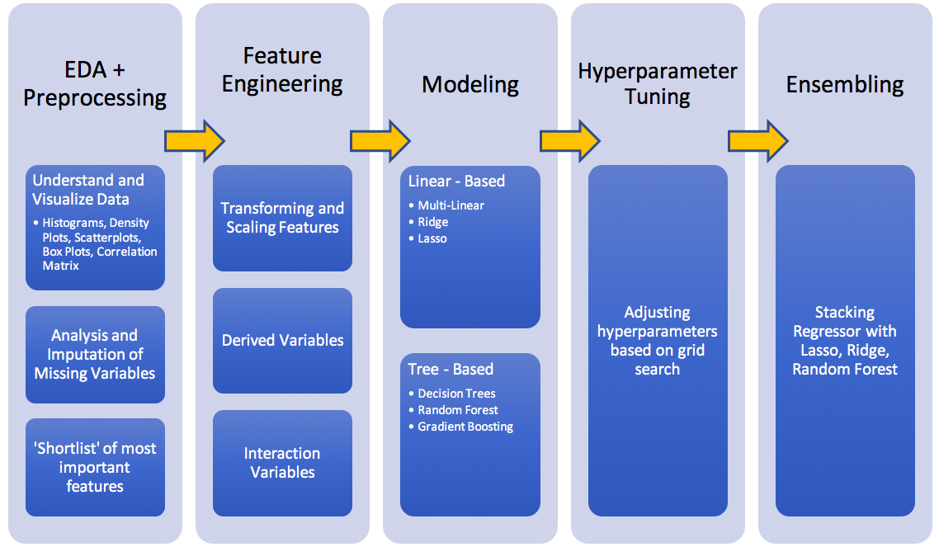
Workflow

Slide 3
EDA

Slide 4
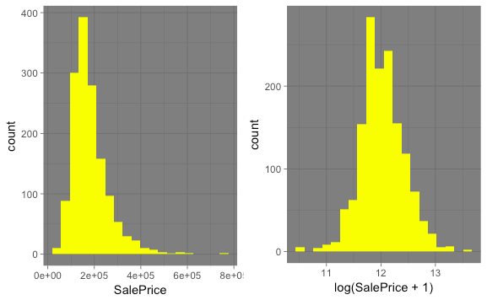
EDA - Sale Price Histogram

Slide 5
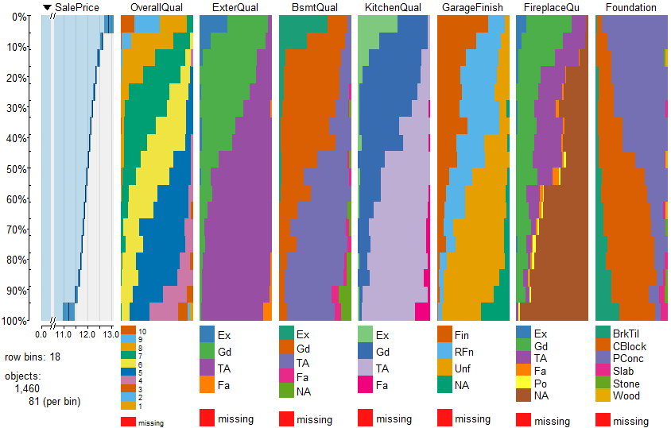
EDA - Categorical Vars

Slide 6
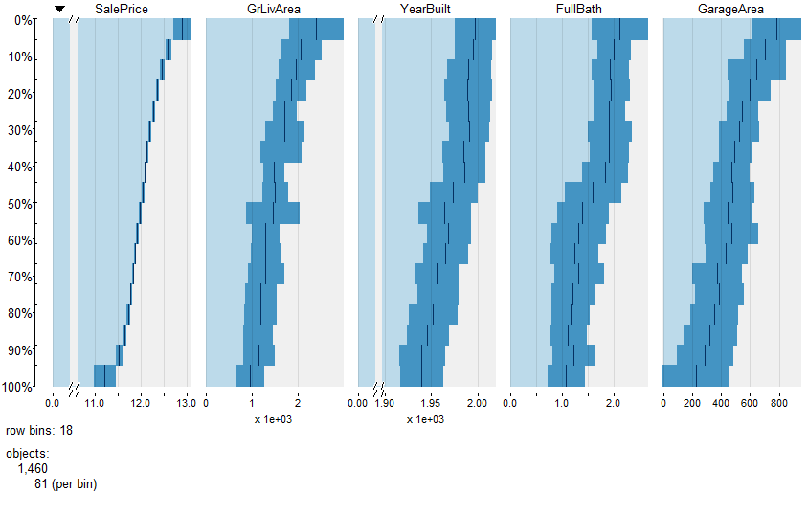
EDA - Continuous Vars

Slide 7
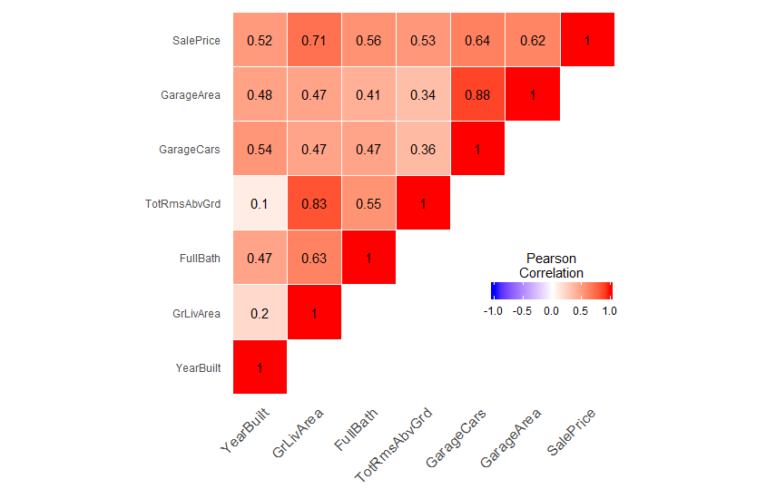
EDA – Correlation Plots

Slide 8
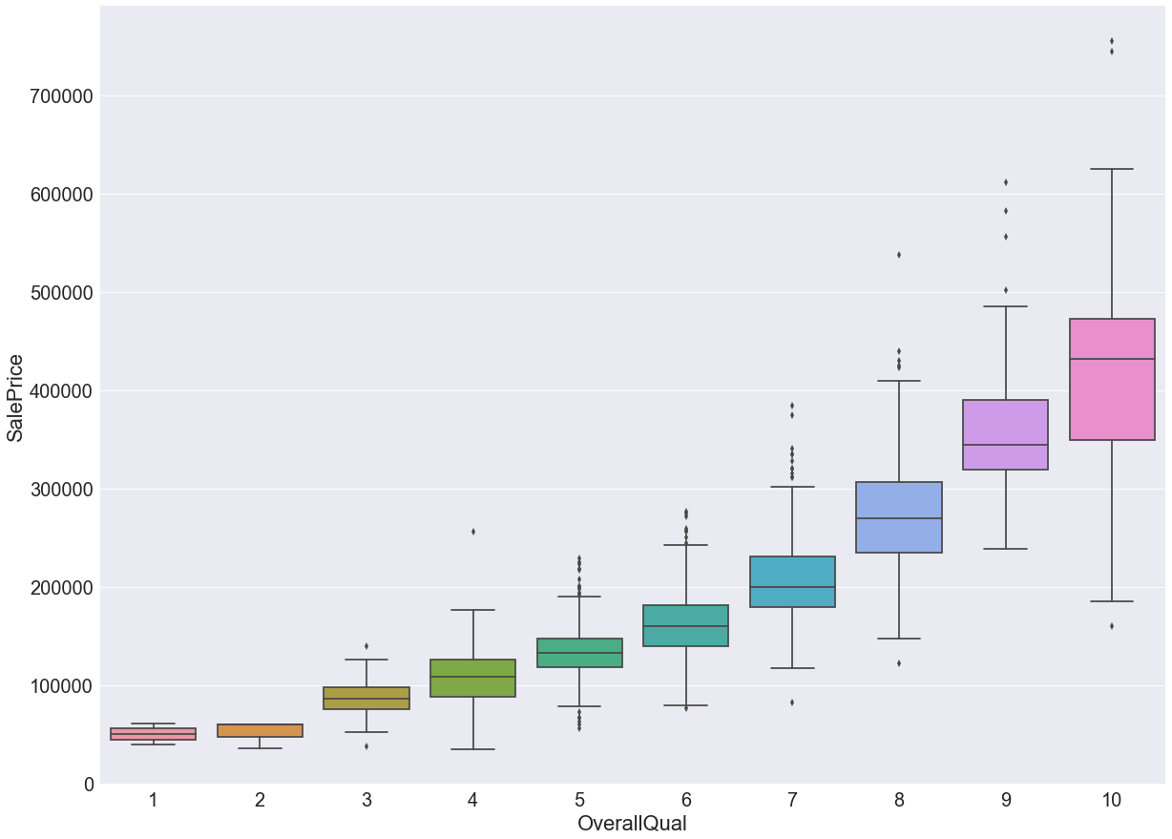
EDA - OverallQual

Slide 9
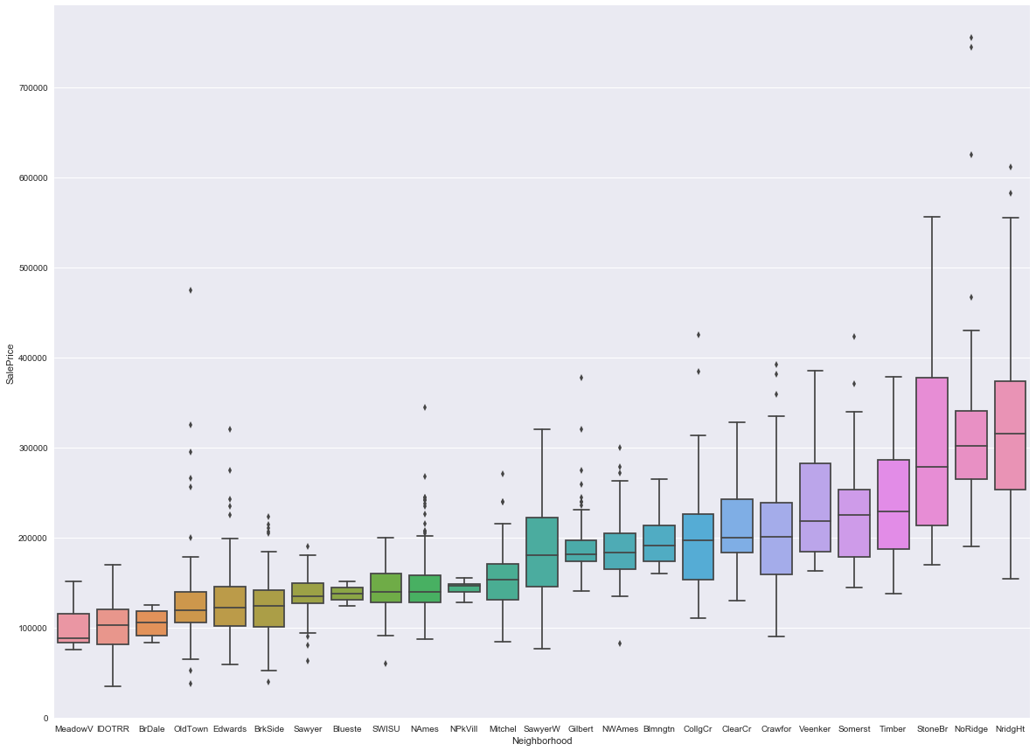
EDA - Neighborhood

Slide 10
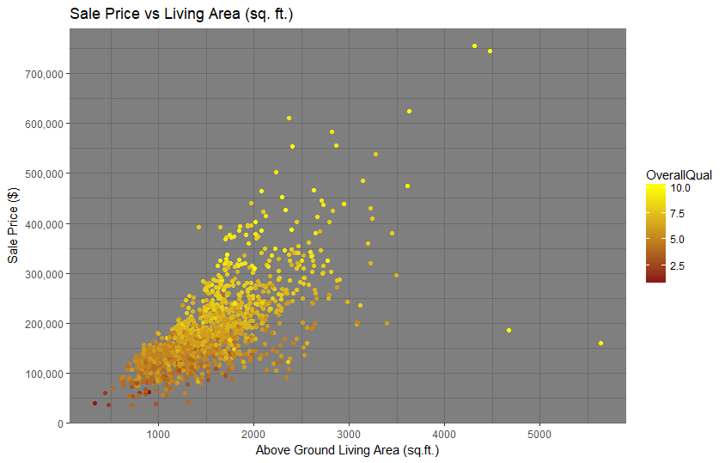
EDA - Scatterplot

Slide 11
Feature Engineering

Slide 12
Imputation
Categorical
Variables
Numerical
Variables
Fill NAs : Mode
MSZoning
Electrical
KitchenQual
SaleType
Fill NAs : Median
LotFrontage
(Neighborhood Median)
Fill NAs : None
PoolQC
MiscFeature
Alley
Fence
BsmtQual
BsmtCond
Fill NAs : 0
BsmtFullBath
GarageCars
GarageArea
MasVnrArea

Slide 13
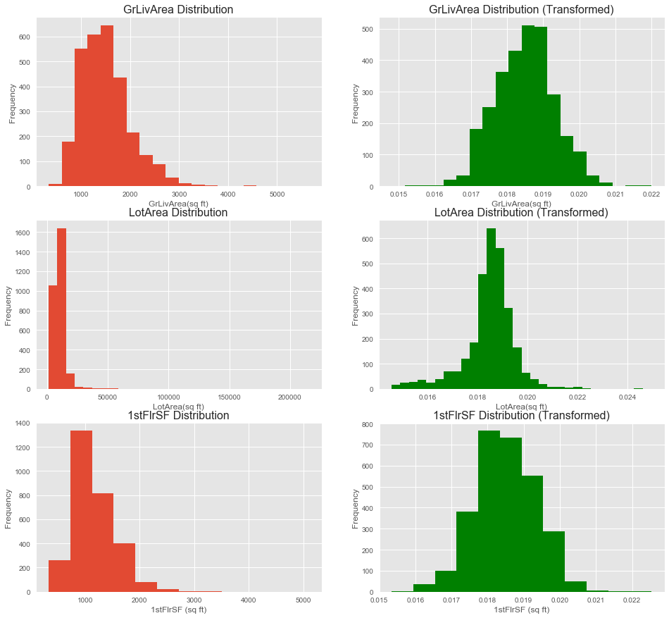
Feature Scaling & Skewness

Slide 14
Linear Models
Multiple Linear Regression
Explored Initial shortlist of 20 Features
Narrowed list to 5 features
Performed Regression
Ridge/Lasso
Explored Interaction of Features
Expanded Shortlist with Interaction Features

Slide 15
Multiple Linear Regression
Shortlist of 20 Features
(Red ones used in Initial Regression)
Location | Style | Condition | Size | Other
Neighborhood | HouseStyle | OverallQual | GrLivArea | SaleCondition
MSZoning | Foundation | OverallCond | 1stFlrSF, 2ndFlrSF | SaleType
 | GarageFinish | YrBuilt | FullBath
 | Paved Drive | ExterQual | TotRms
 |  | BsmtQual | GarageCars
 |  |  | GarageArea

Slide 16
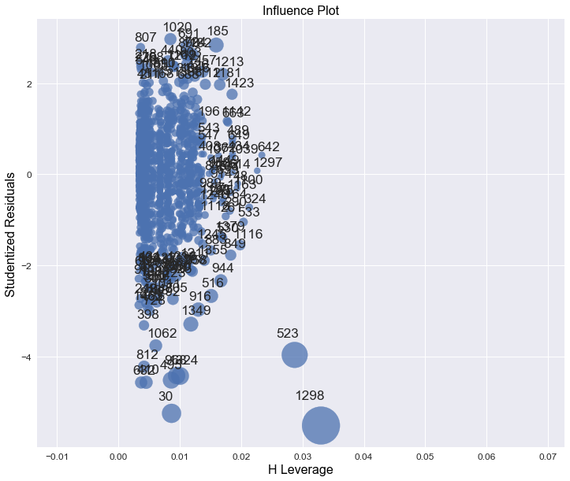
Multiple Linear Regression

Slide 17
Multiple Linear Regression
 | R^2 (Training Set) | RMSE (Training Set)
With Influential Points | 0.800 | 0.178
Without Influential Points | 0.807 | 0.176

Slide 18
Feature Engineering

Slide 19
Derived Features
TotalSF = TotalBsmtSF + GrLivArea
HighQualFinishedSF
= TotalSF - LowQualFinSF
TotalBaths
= Full Baths + BsmtFullBath +
0.5 * (Half Baths + BsmtHalfBath)

Slide 20
Interaction Features
Examples of Numeric Interactions:
TotalBaths * Total Square Footage
OverallQual (as int) * Total Square Footage
Examples of Categorical Interactions:
OverallQual + OverallCond
Neighborhood + OverallQual + OverallCond

Slide 21
RIDGE/LASSO PROCESS
Split training data 80%/20%
Used grid search to tune hyperparameter
5-fold cross-validation for each parameter value
Tested against remaining 20%
Trained against entire 100% of training set

Slide 22
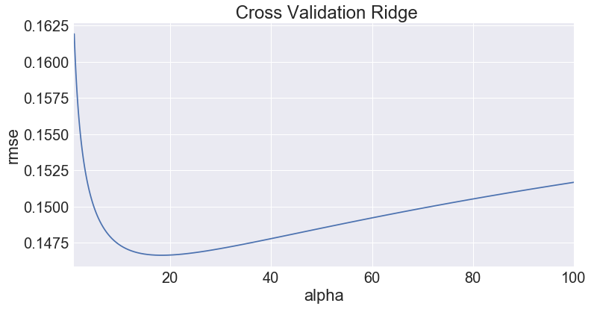
Ridge Regression
Best Alpha = 18.7

Slide 23
Ridge Regression
 | R^2 | RMSE
SUB-TRAINING SET (80%) | 0.938 | 0.100
TEST SET (20% | 0.913 | 0.111
TOTAL TRAINING SET (100%) | 0.933 | 0.099

Slide 24
Ridge Regression
Top Features | Coefficient Value
OverallCond_3 | -0.066691
Neighborhood + OverallQual + OverallCond_Edwards10+5 | -0.066562
MSSubClass_160 | -0.051320
Neighborhood_Edwards | -0.048231
Neighborhood + OverallQual + OverallCond_IDOTRR4+4 | -0.048116
Neighborhood_Crawfor | 0.048117
CentralAir_Y | 0.049257
MSZoning_RL | 0.053233
OverallQual | 0.057236
Functional_Typ | 0.057430

Slide 25
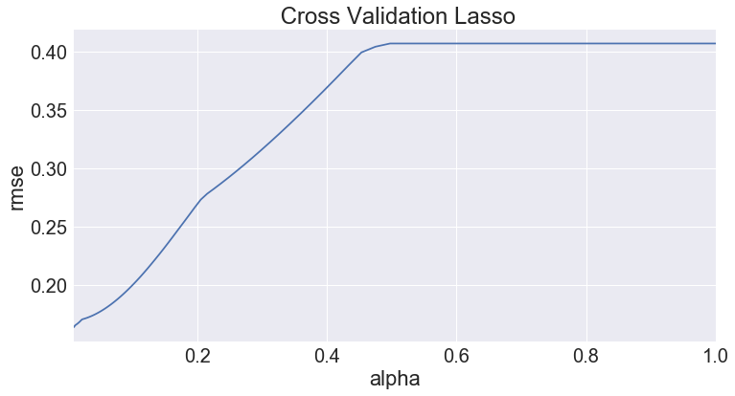
Lasso Regression

Slide 26
Lasso Regression
 | R^2 (Training Set) | RMSE (Training Set)
SUB-TRAINING SET (80%) | 0.839 | 0.163
TEST SET (20%) | 0.838 | 0.137
TOTAL TRAINING SET (100%) | 0.843 | 0.159

Slide 27
Lasso Regression
Top Features | Coefficient Value
Neighborhood_IDOTRR | -0.106394
Neighborhood_OldTown | -0.098231
OverallQual + OverallCond _5+3 | -0.088836
Neighborhood_MeadowV | -0.075524
BsmtQual + BsmtCond_Ta+FA | -0.072136
Heating + HeatingQC_GasA+Ex | 0.066236
Neighborhood_Crawford | 0.068795
TotalFinishedSF | 0.075379
OverallQual | 0.098205
SaleType+SaleCondtion_New+Partial | 0.128627

Slide 28
Tree Based Models

Slide 29
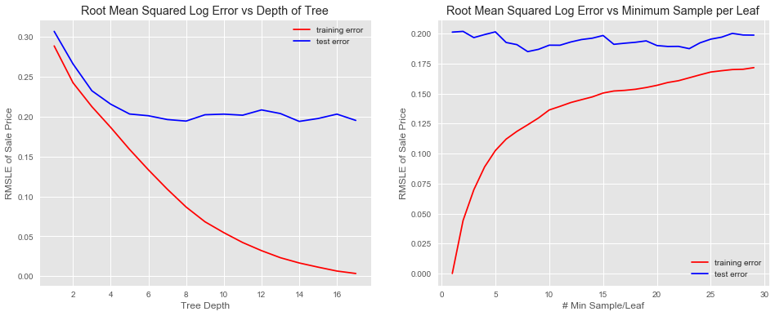
Decision Trees

Slide 30
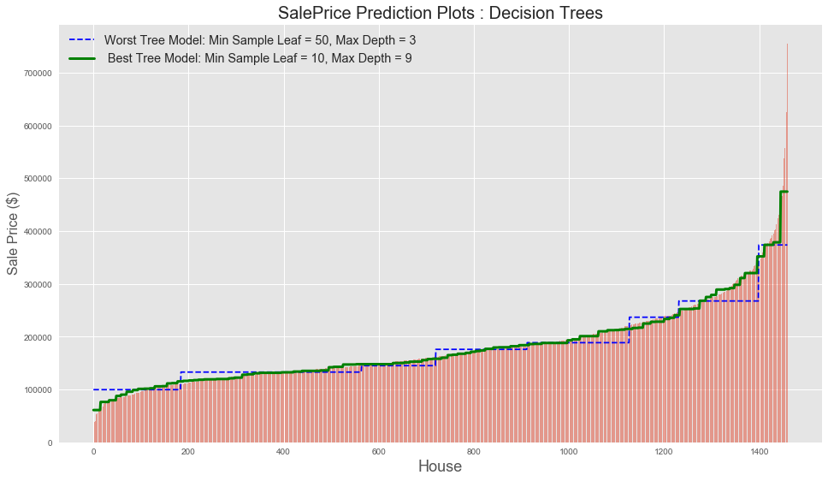
Decision Trees

Slide 31
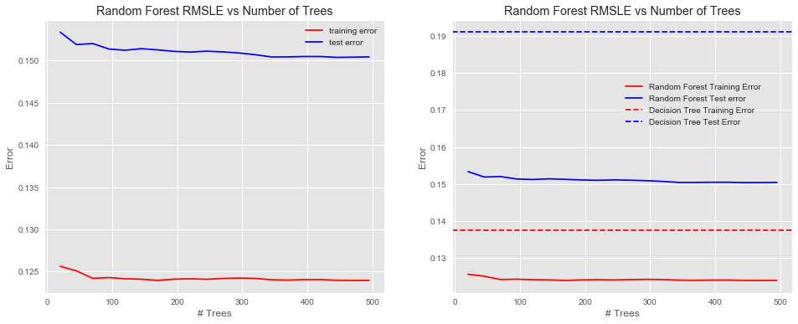
Random Forest

Slide 32
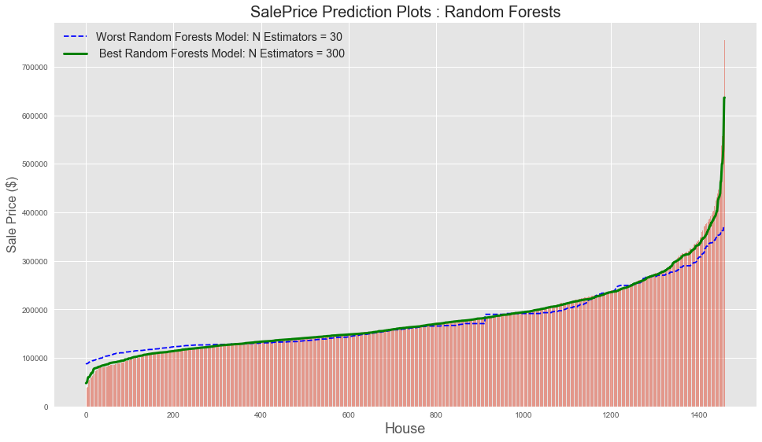
Random Forests

Slide 33
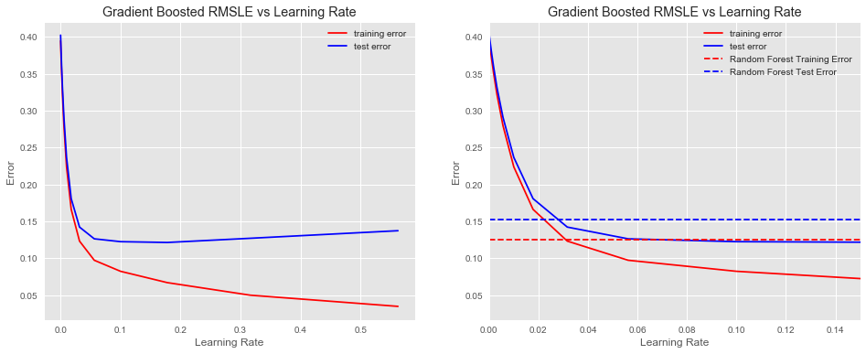
Gradient Boosting

Slide 34
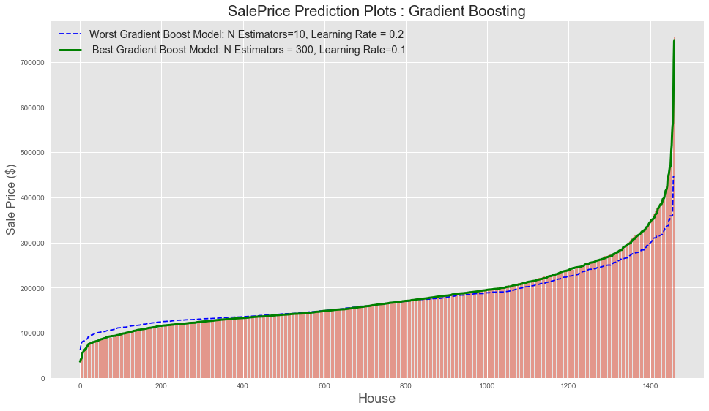
Gradient Boosting

Slide 35
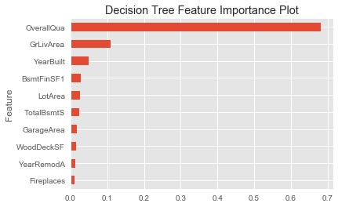
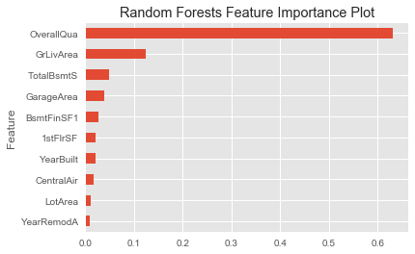
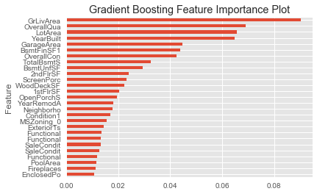
Tree Based Variable Importance

Slide 36
Tree Based Models
CV Grid Search

Slide 37
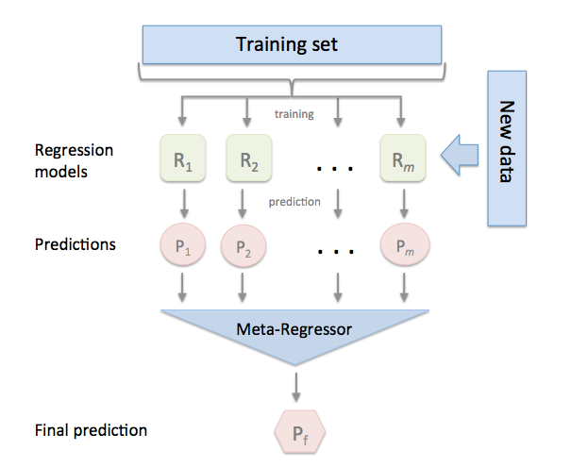
Ensemble Model
Stacking Regressor
Ridge Regression
Lasso Regression
Random Forests
Lasso
Meta Regressor
[ Package MLXTEND ]

Slide 38
Ensemble Model Results

Slide 39
Models Results

Slide 40
Conclusion
Vital Steps
Feature Engineering
Surprising results with respect to most important features based on coefficients
Hyperparameters Tuning
Model Performance:
Ridge Regression
Lasso Regression (within ensembling process)

